Slide 1
An order-ambivalent presentation-dependent allocation of operators to solving vacuum and gravity problems
Maximilian Weinhold

Slide 2
* ; 0 ; 1*
An interaction defined through its definition.
A limiting reference
An amplifying reference
; * is amplifying

Slide 3
* ; a, b ; A / B ;AB/=0 ; A*B / A / B
; * is multiplying

Slide 4
* ; A/b ; A*B
If A or B = 0
A*B determinately 0 .
If A or B = 1
A*B = 1 xor (A xor B)
; * is multiplying

Slide 5
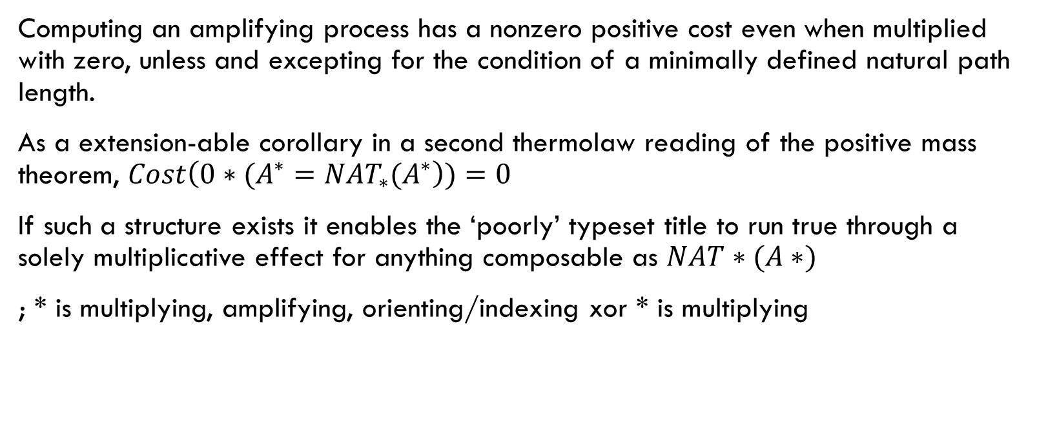
* ; cost(0*A*) > 0 xor Nat*(A*) == TRUE
Computing an amplifying process has a nonzero positive cost even when multiplied with zero, unless and excepting for the condition of a minimally defined natural path length.
As a extension-able corollary in a second thermolaw reading of the positive mass theorem, $Cost\left(0∗{(A^{∗}=NAT_{∗}(A}^{∗}\right))=0$
If such a structure exists it enables the ‘poorly’ typeset title to run true through a solely multiplicative effect for anything composable as $NAT∗(A∗)$
; * is multiplying, amplifying, orienting/indexing xor * is multiplying

Slide 6
B* could be B
To allow some transience of molecular open-form multiplication, when appearing as a multiplicative element missing a partner we create the expectation (average) of the whole(base). The variance around the base, or even it’s distribution, is left to the particulars of *
; * is treated as a probabilistic element.

Slide 7
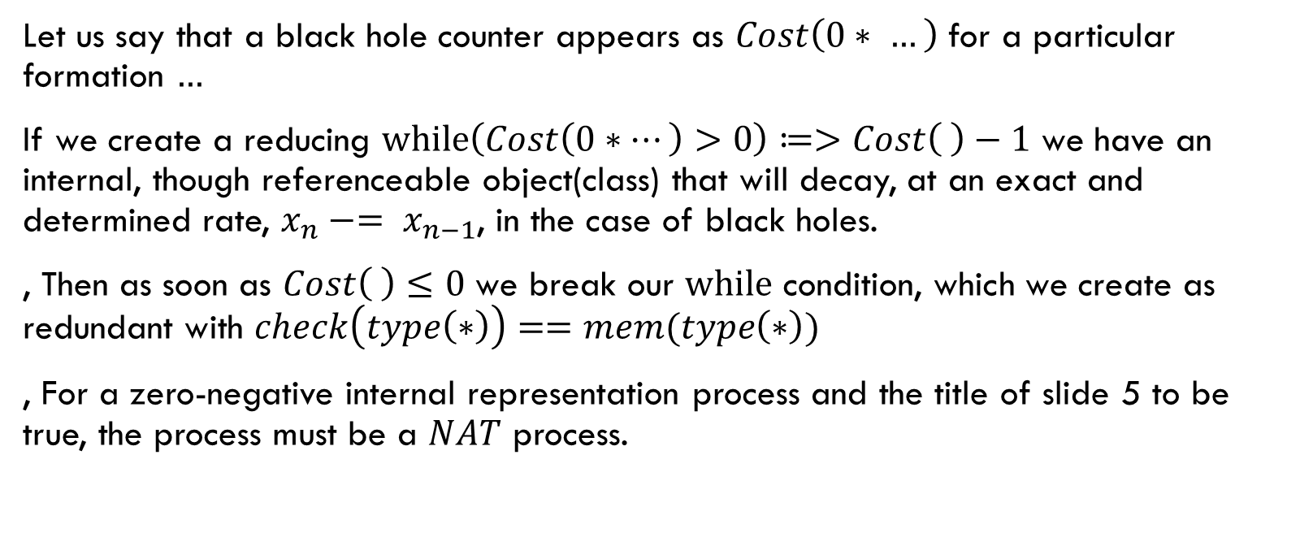
The patchy case for Black Holes
Let us say that a black hole counter appears as $Cost\left(0∗ …\right)$ for a particular formation $…$
If we create a reducing $while\left(Cost\left(0∗…\right)>0\right)≔>Cost\left( \right)−1$ we have an internal, though referenceable object(class) that will decay, at an exact and determined rate, $x_{n}−= x_{n−1}$, in the case of black holes.
, Then as soon as $Cost\left( \right)≤0$ we break our $while$ condition, which we create as redundant with $check\left(type\left(∗\right)\right)==mem(type\left(∗\right))$
, For a zero-negative internal representation process and the title of slide 5 to be true, the process must be a $NAT$ process.

Slide 8
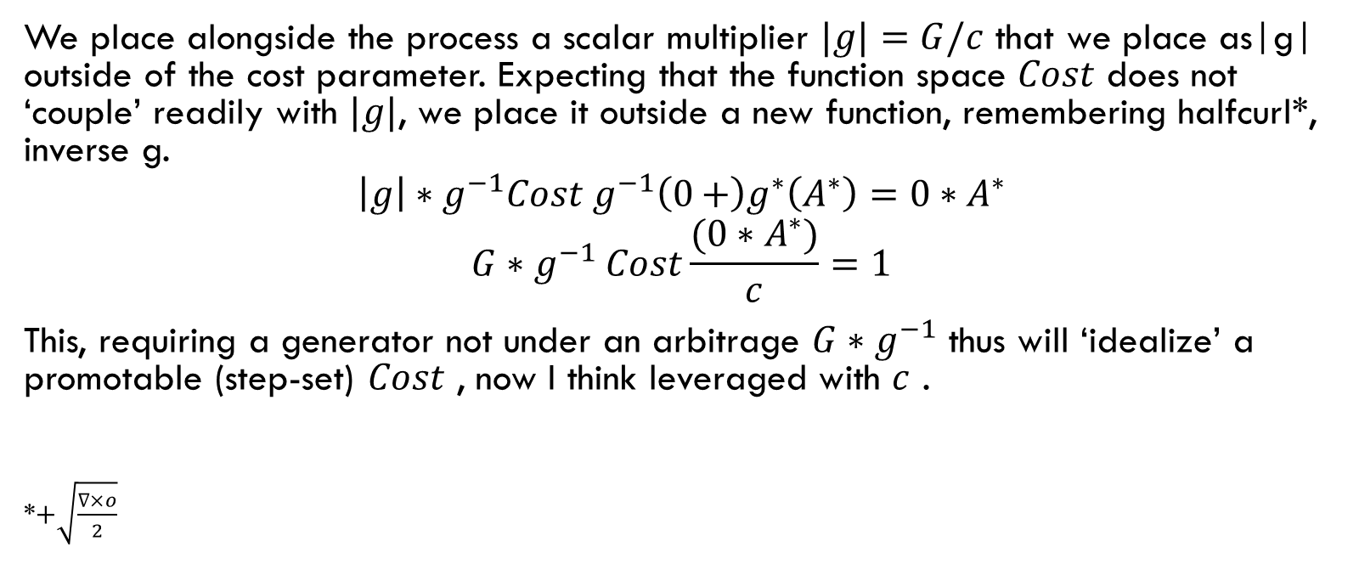
& gravity
We place alongside the process a scalar multiplier $|g|=G/c$ that we place as|g| outside of the cost parameter. Expecting that the function space $Cost$ does not ‘couple’ readily with $|g|$, we place it outside a new function, remembering halfcurl*, inverse g.
$${\left|g\right|∗g}^{−1}Cost g^{−1}\left(0+\right)g^{∗}\left(A^{∗}\right)={0∗A}^{∗}$$
$$G{∗g}^{−1}Cost\frac{(0∗A^{∗})}{c}=1$$
This, requiring a generator not under an arbitrage $G∗g^{−1}$ thus will ‘idealize’ a promotable (step-set) $Cost$ , now I think leveraged with $c$ .
*$+\sqrt{\frac{∇×o}{2}}$

